Slide 1
3D POINT CLOUD CLASSIFICATION USING DEEP LEARNING
BATCH – 14
GUIDE
Mrs.Sangeetha Kalyanaraman
TEAM MEMBERS
Jennisha Christina Martin(211417104097)
Sivasankari R(211417104261)
Sakthi R V(211417104231)

Slide 2
INTRODUCTION
In the last few years, the availability of 3D content is still less than 2D counterpart. Hence many 2D-to-3D image conversion methods have been proposed. Methods involving human operators have been most successful but also time- consuming and costly.
Automatic methods, that make use of a deterministic 3D scene model, have not yet achieved the same level of quality for they rely on assumptions that are often violated in practice. Here two types of methods are developed.
The first is based on learning a point mapping from local image/attributes, such as color, spatial position.
The second method is based on globally estimating the entire depth map of a query image directly from a repository of 3D images (image + depth pairs or stereo pairs) using a nearest-neighbour regression type idea.It demonstrates the ability and the computational efficiency of the methods on numerous 2D images and discusses their drawbacks and benefits

Slide 3
LITERATURE SURVEY
Year of Publication | Author Name | Title of the Paper | Merits | Demerits
2020 | Yulan Guo Hanyun Wang Qingyong Hu Hai Liu Li Liu Mohammed Bennamoun | Deep learning for 3D Point clouds | A promising solution is to address the raw point clouds with the ConvNets. Since ConvNets has the advantage of overlapping during convolutional operation may benefit the future | It is very expensive and it has included some challenges to over it the irregular network connection will reduce the performance
https://www.ncbi.nlm.nih.gov/pmc/articles/PMC6806315/#!po=44.5652

Slide 4
Year of Publication | Author Name | Title of the Paper | Merits | Demerits
2019 | Jiaojiao Tian Yuxing Xie Xiao Xiang Zhu | 3D Point Cloud Semantic Segmentation | 1. In With color (RGB, multi-spectral) information suitable for large area. 2.High accuracy suitable for large area not affected by weather 3. Global data is available compared to ALS complete building façade information middle accuracy not affected by weather. | 1.Influenced by light accuracy depends on available precise camera models image matching algorithms stereo angles image resolution and image quality not suitable for areas or objects without texture such as water or snow-covered regions influenced by shadows in images. 2. Expensive affected by mirror reflection long scanning time. 3. Close-range limited accuracy.
https://ieeexplore.ieee.org/document/9028090

Slide 5
Year of Publication | Author Name | Title of the Paper | Merits | Demerits
2019 | XIAOLI LIANG ZHONGLIANG FU | MH Net: Multiscale Hierarchical Network for 3D Point Cloud Semantic Segmentation | 1 To take fully advantage of the correlations of Propagated information between the different scale coarse layers and the original points, the local features of each scale are characterized by feature propagation to obtain the features of the original point clouds at the corresponding scale. | 1. Although there is considerable noise points in the segmentation result of MH Net, the number of noise point’s only accounts for a small part of the total point clouds. Even If all the noise points are corrected, the overall accuracy of the point clouds will not be greatly improved.
https://ieeexplore.ieee.org/search/searchresult.jsp?newsearch=true&queryText=3d%20point%20c loud%20classification%20using%20cnn

Slide 6
Year of Publication | Author Name | Title of the Paper | Merits | Demerits
2015 | Anh Nguyen Bac Le | 3D Point Cloud Segmentation | 1. In addition, advance in machine learning techniques have made accurate classification of scene context possible 2. A method that takes advantage of contextual information combine with geometric reasoning or learning techniques would improve the segmentation results. | 1.In addition, The surface shape can be arbitrary with sharp features and there is no statistical distribution pattern in data. 2. Moreover, due to the limitations of the 3D sensors, the foreground is often highly entangled with the background. 3. These problems present a difﬁcult challenge when designing a segmentation algorithm.
https://www.researchgate.net/publication/269035150_3D_point_cloud_segmentation_A_survey

Slide 7
Year of Publication | Author Name | Title of the Paper | Merits | Demerits
2017 | Charles R.Qi Hao Su Kaichun Mo Leonidas J. Guibas | PointNet: Deep Learning on Point sets for 3D Classification and Segmentation | Point Net is Highly efficient and effective Empirically, it shows strong performance on even better than state of the art. Point Clouds are simple and unified structures that avoid the combinational irregularities and complexities of meshes, and thus are easier to learn . | Point Cloud is Expensive affected by mirror reflection long scanning time. Point cloud deals with limited accuracy.
https://arxiv.org/pdf/1612.00593v2.pdf

Slide 8
PROBLEM STATEMENT
The main aim of this Project is “Image Reconstruction” - to reconstruct a 2D image to a 3D image ,The convenience of 3D-capable hardware today, such as TVs, Blu-Ray players, gaming consoles, and smart phones, is not yet matched by 3D content production. Today there exists an urgent need to convert the existing 2D content to 3D.
The proposed methods carry the philosophy of machine learning. They apply to arbitrary scenes and require no manual explanation. Two types of method proposed : The first one is based on learning a point mapping from local image/attributes, such as color, spatial position, and motion at each pixel, to scene-depth at that pixel using a regression type idea

Slide 9
The second one is based on globally estimating the entire depth map of a query image directly from a repository of 3Dimages (image + depth pairs or stereo pairs) using a nearest-neighbor regression type idea. It introduces local method and evaluates the qualitative performance and the computational efficiency of both the local and global methods
The improved quality of the depth maps produced by the global method relative to state of-the- art methods together with up to 4 orders of magnitude reduction in computational effort and weakness of the methods are also demonstrated. But no performance against these methods while comparing with other works.

Slide 10
TECHNOLOGY STACK
Input Requirements : PNG File .
Output Requirements : Mat lab Plot Format / 3Dimensional perspective of corresponding 2d input image
Hardware Environment : Laptop or Desktop – 1 GB ram & 500 GB hard
Disk & I3 Processor.
Software Environment : Mat lab 2018 a & windows 10.

Slide 11
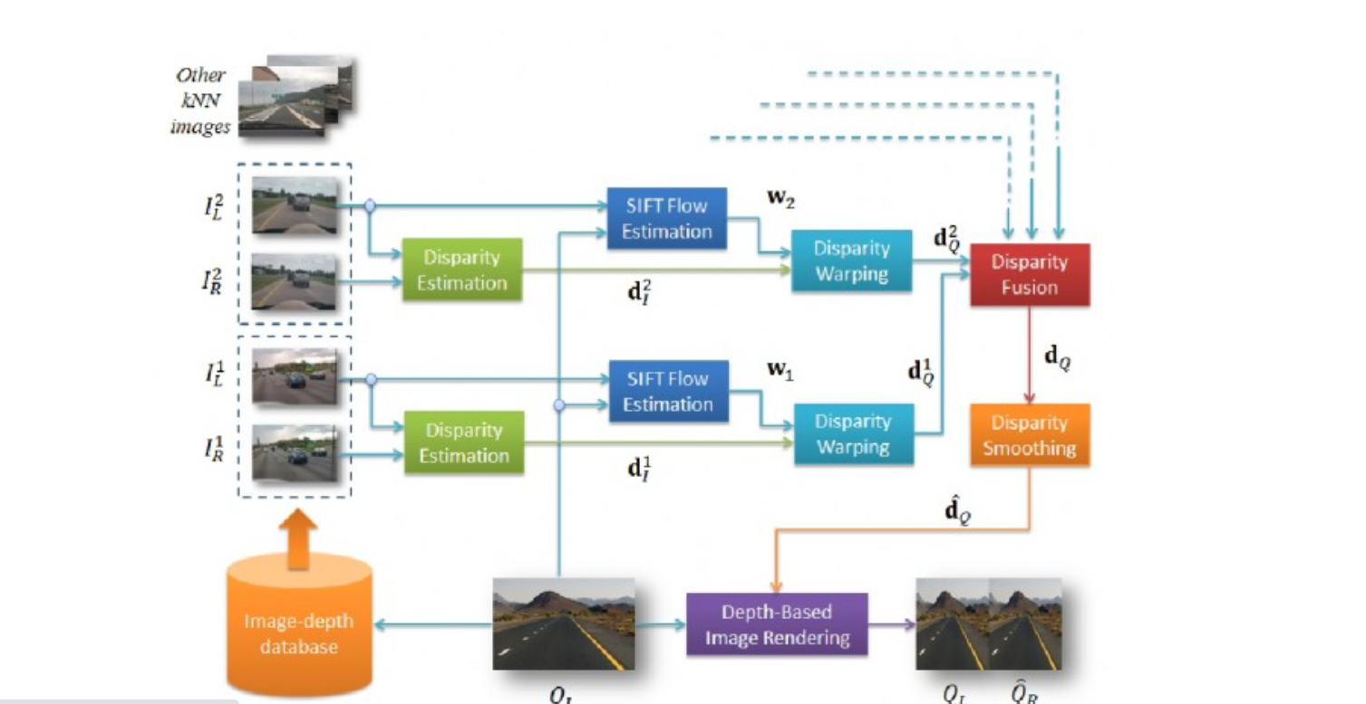
SYSTEM ARCHITECTURE

Slide 12
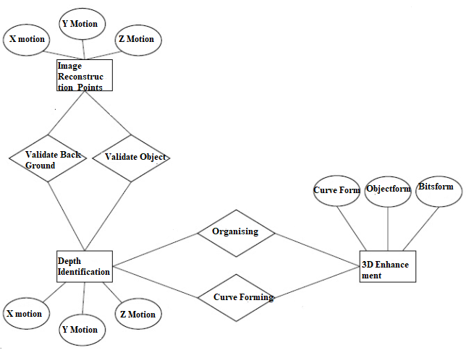
SYSTEM DESIGN
ER - DIAGRAM

Slide 13
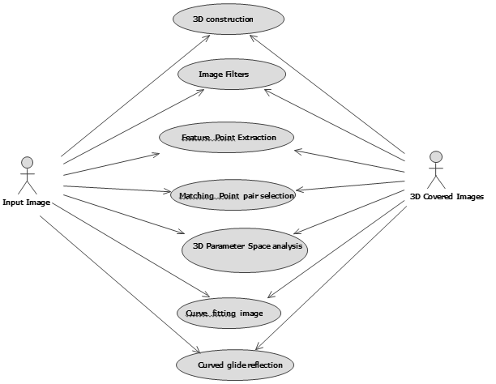
USE CASE – DIAGRAM

Slide 14
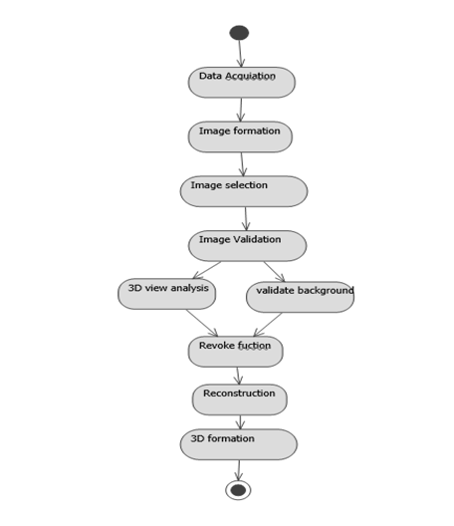
ACTIVITY DIAGRAM

Slide 15
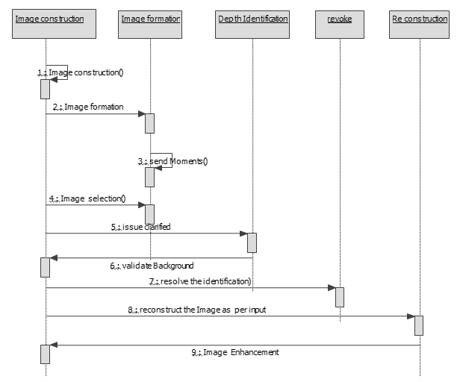
SEQUENCE DIAGRAM

Slide 16
MODULE DESCRIPTION:
Our project is having the following modules:
The project will be split into 3 Modules
data collection
depth map generation/fusion
3D visualization. Images will be obtained off-line.

Slide 17
Experiment Setup:
I) Data Collection :
One of the main goals of the experimental setup is to keep the project within scope. The experiment will be designed such that one can recreate 3D images from 2D images without deviating much from the themes.
Furthermore, the goal of the experiment is to create a scenario in which on can avoid some of the obstacles faced 25 during the 2D to 3D conversion Process .

Slide 18
II) Generating 3D Information :
The second portion of the project will involve generating a depth map using the 2D images collected at each α (i.e. at different points on the circle in Figure 3). 29 It may be possible that only a small set of the images are used during 3D reconstruction .
The depth generation algorithms are roughly classified into three categories which utilize different kinds of depth cues : the binocular, monocular and pictorial depth cues.
The approach to obtain the depth map in the scene closest to the observer will translate much less than objects furthest away from the observer as θ varies. The goal is to represent the depth map in the form of a 256 bit image such that many of the techniques learned can be used to process the depth map images

Slide 19
III) Visualization:
The final portion of the project will involve rendering the 3D data. In this step, the depth information generated in Step 2 will be rendered using OpenGL. GLUT will be used to provide a simple method for a user to observe the rendered 3D object

Slide 20
ALGORITHMS
Search for representative depth fields:
Find k 3D images in the repository I that have most similar depth to the query image, for example by performing a k nearest-neighbor (kNN) search using a metric based on photometric properties.
Depth fusion:
Combine the k representative depth fields, for example, by means of median filtering across depth field.

Slide 21
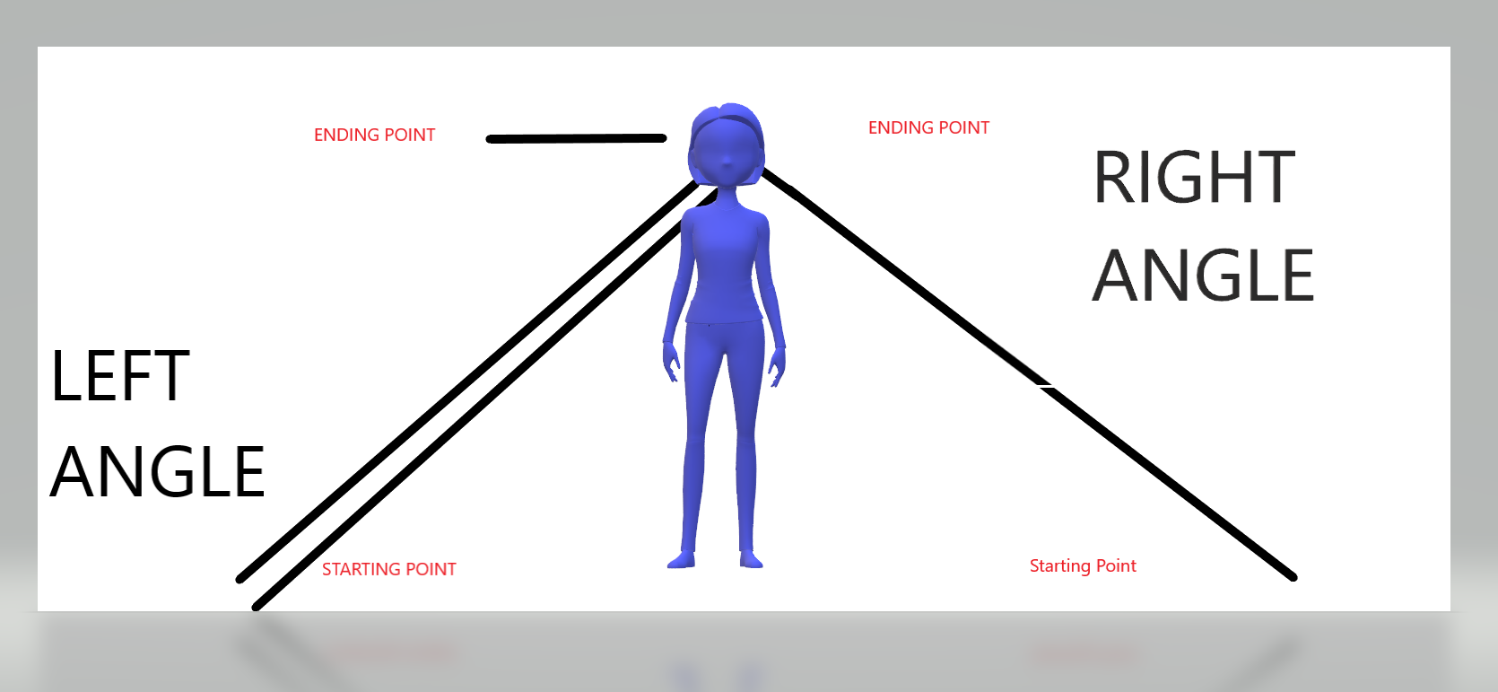
STEP-1 : REPRESENTATIVE DEPTH FIELD

Slide 22
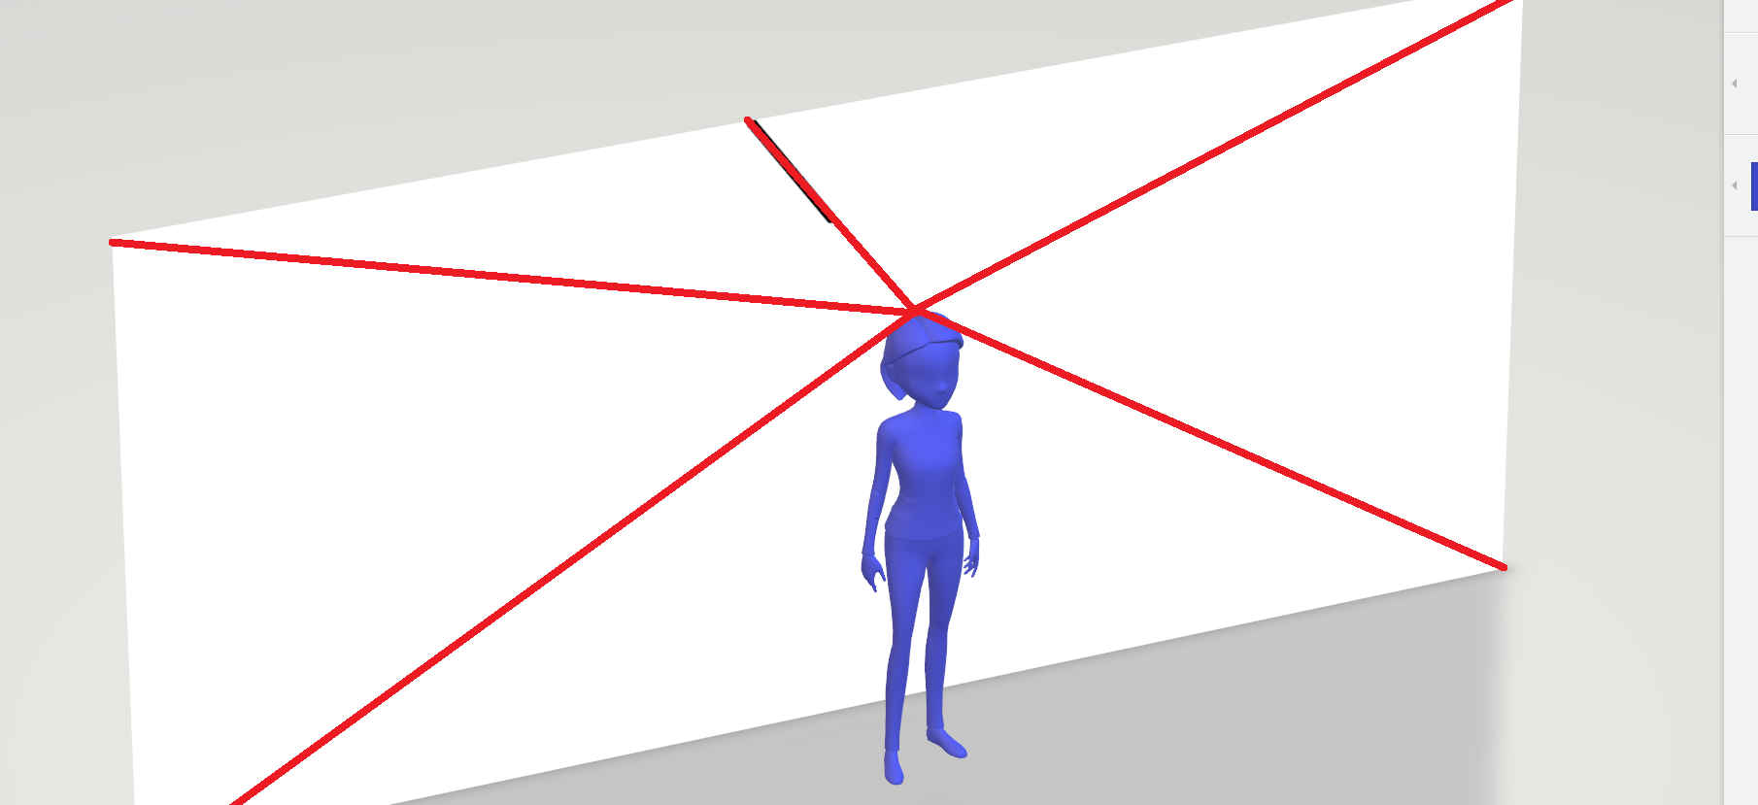
STEP-2 : DEPTH FUSION

Slide 23
Depth smoothing:
Process the fused depth field to remove spurious variations, while preserving depth discontinuities, for example, by means of cross- bilateral filtering.
Stereo rendering:
Generate the right image of a fictitious stereopair using the monocular query image and the smoothed depth field followed by suitable processing of occlusions and newly- exposed areas.

Slide 24
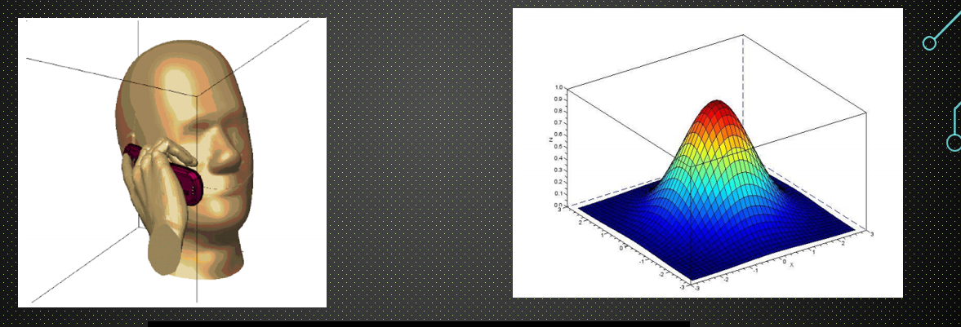
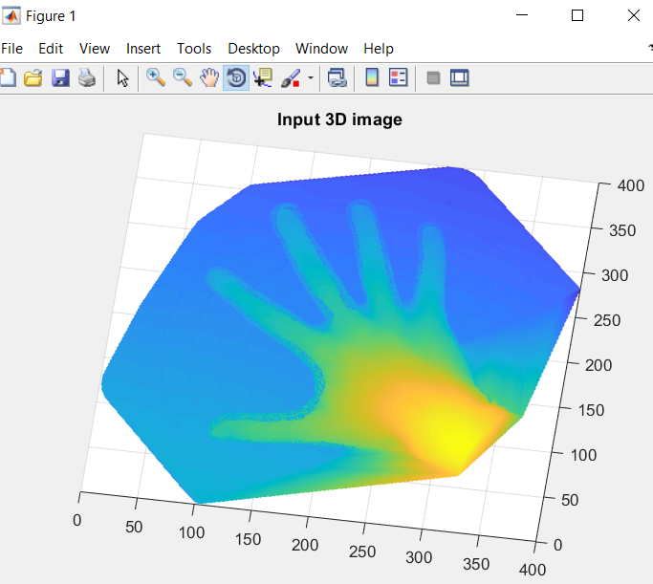
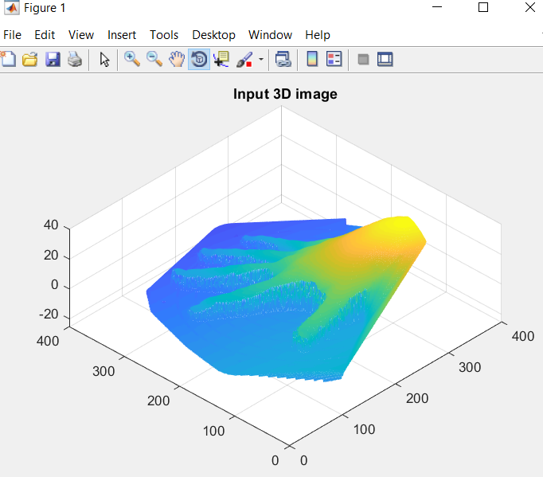
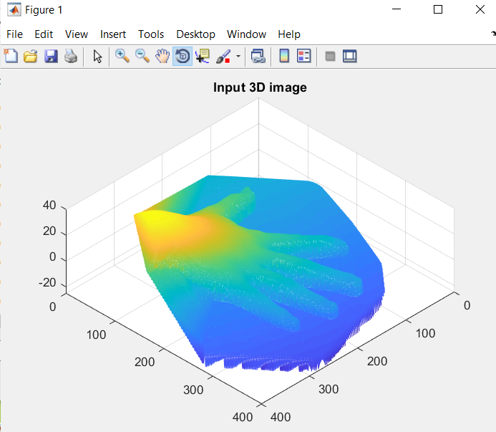
STEP - 3 : SMOOTHING
STEP – 4 : STEREO RENDERING

Slide 25
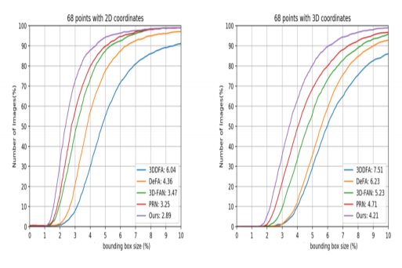
PERFORMANCE ANALYSIS GRAPH
68 Points with 2D VS 3D Coordinates

Slide 26
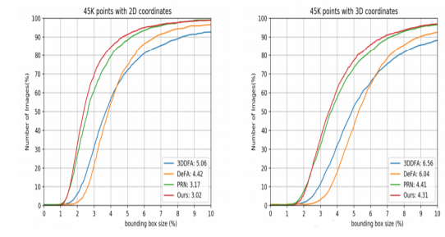
45k Points with 2D VS 3D Coordinates

Slide 27
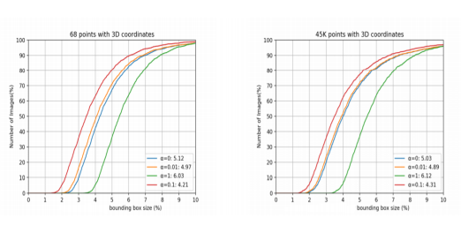
68 Points & 45k points with 3D Coordinates

Slide 28
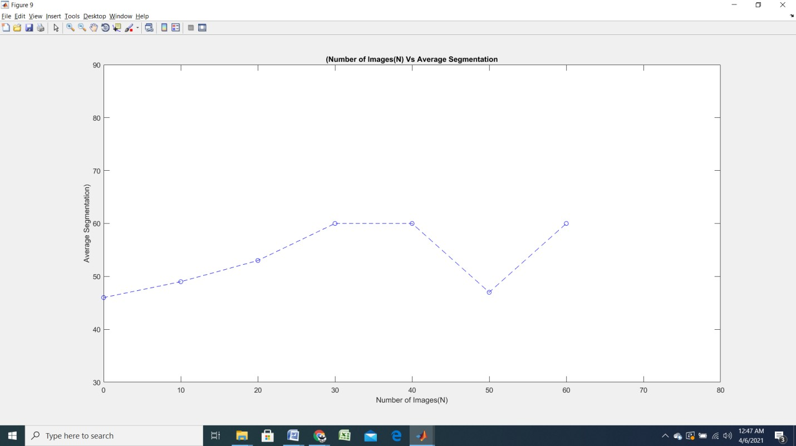

Slide 29
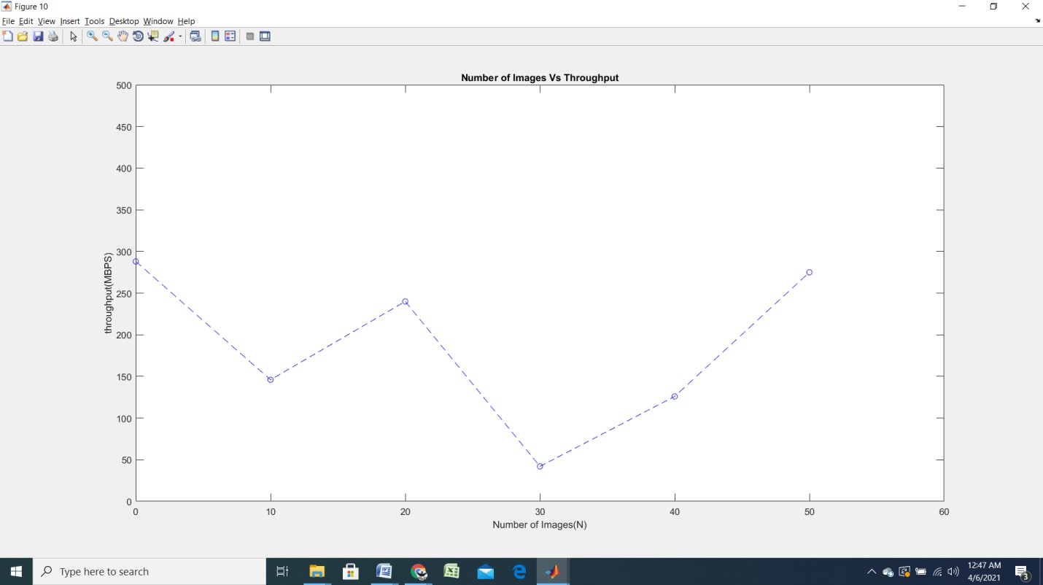

Slide 30
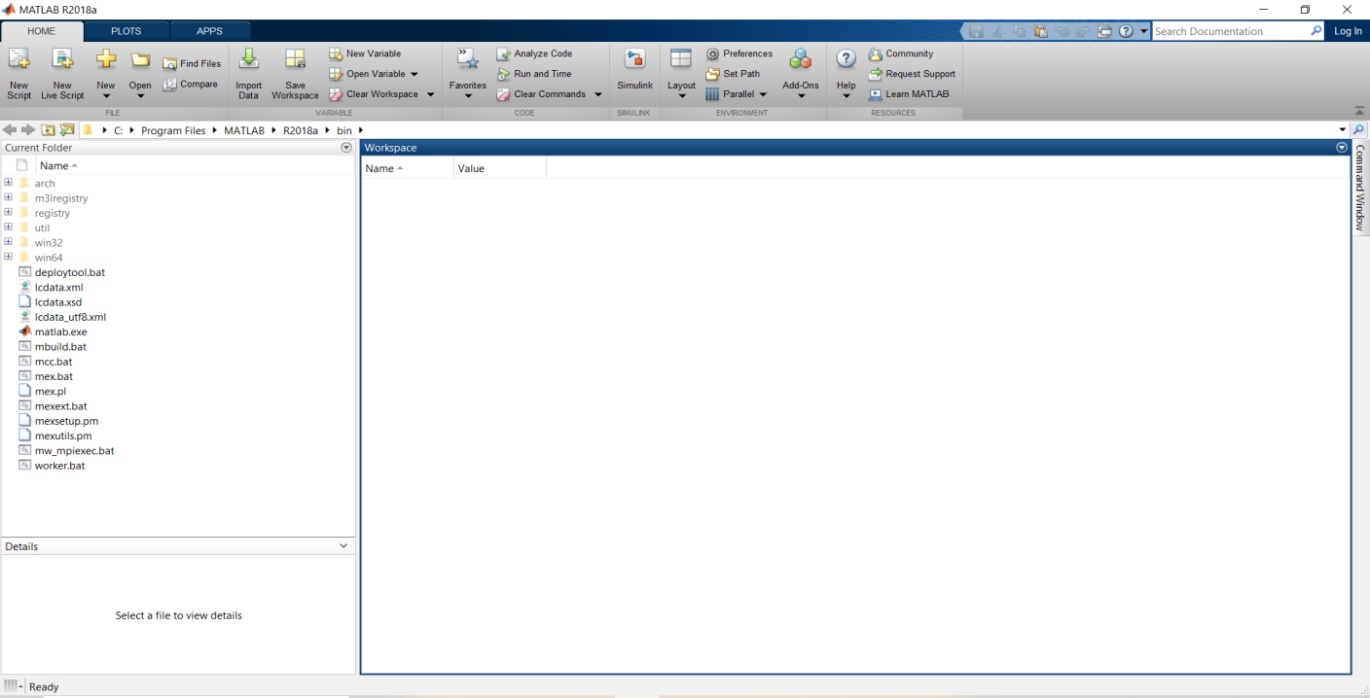
SCREENSHOTS :
INPUT IMAGES :
Figure: A1.1 PROJECT SETUP
1 ) Project Setup

Slide 31
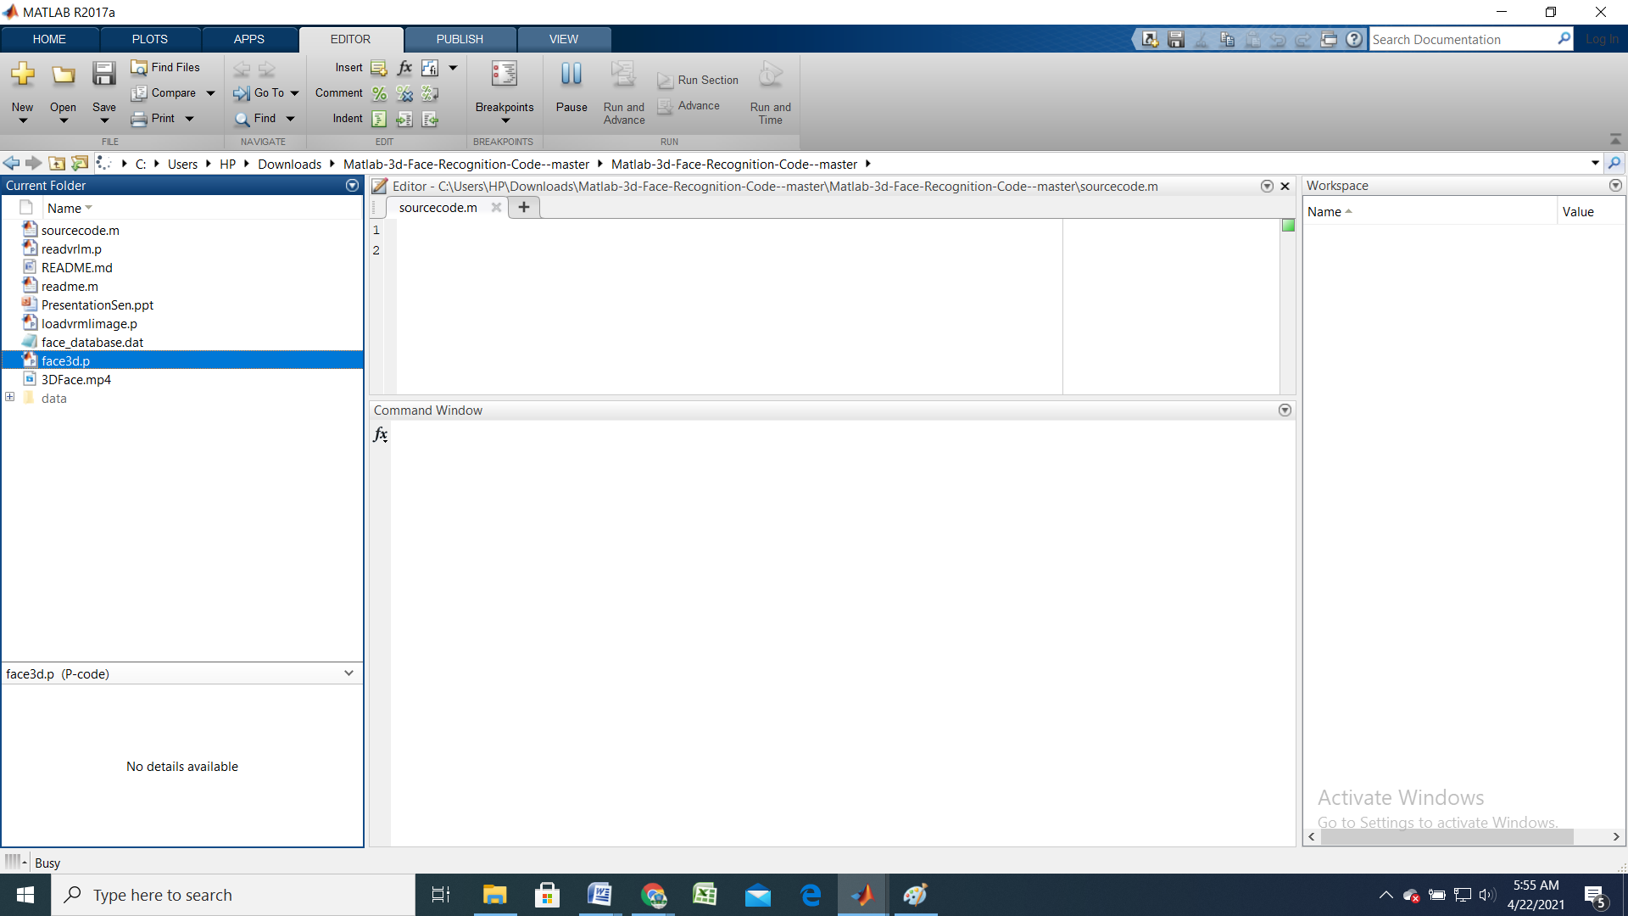
2) Specifying the Source Code Folder

Slide 32
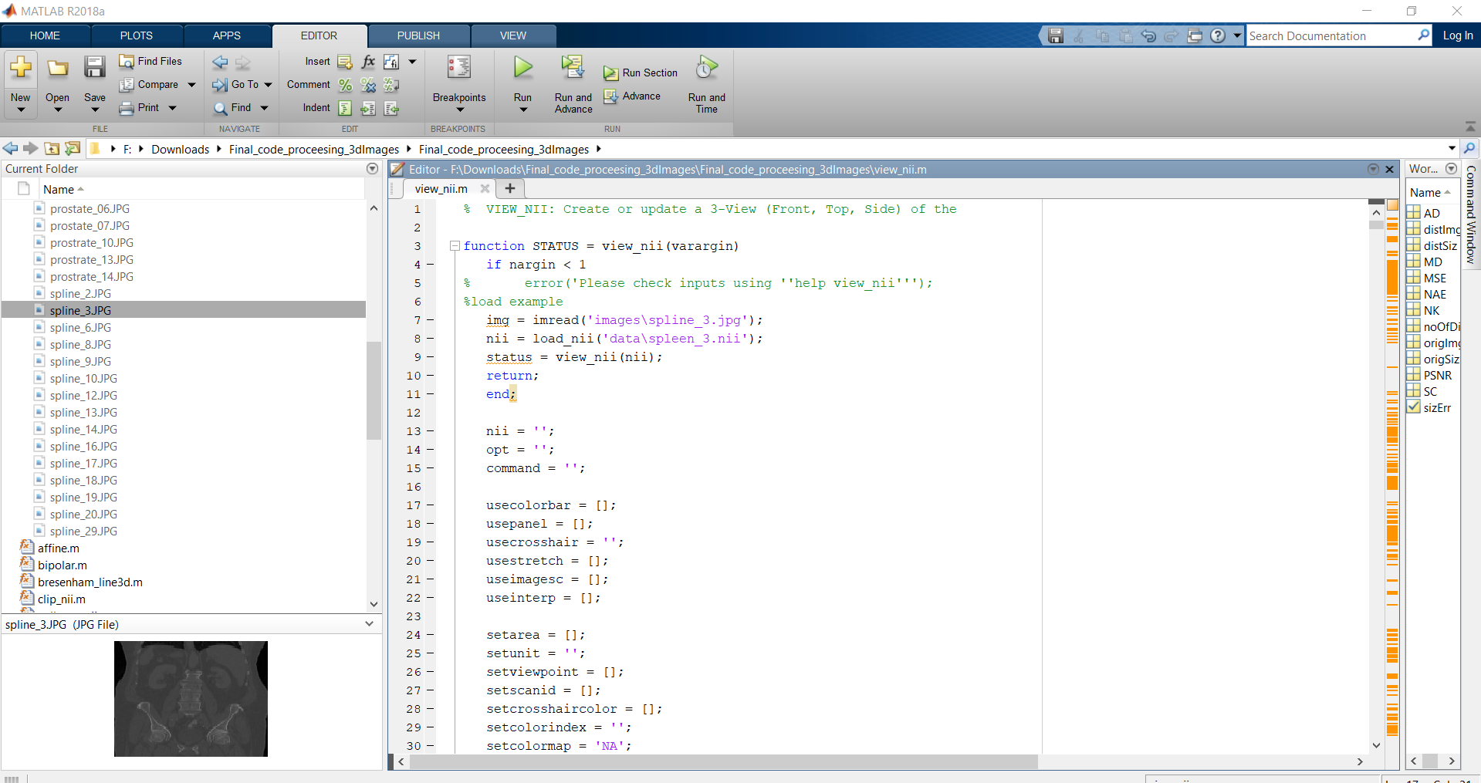
3) Source Code

Slide 33
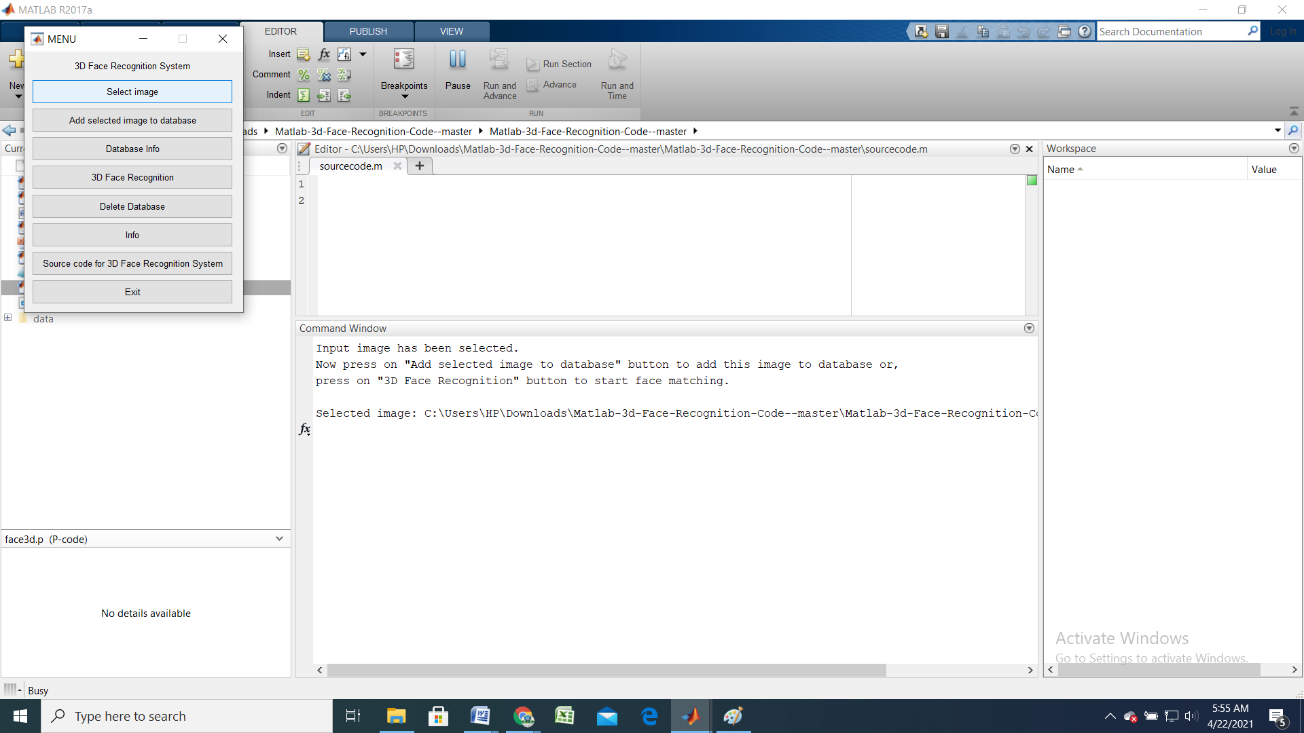
4) Image Selection

Slide 34
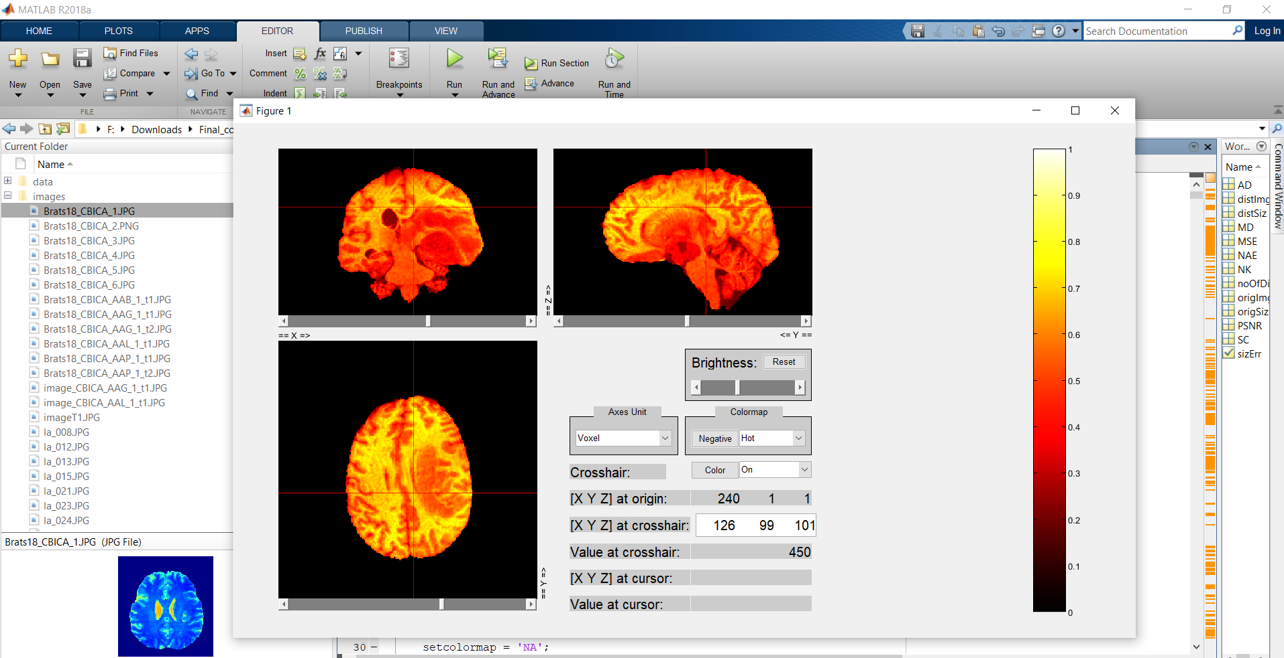
OUTPUT IMAGES :

Slide 35
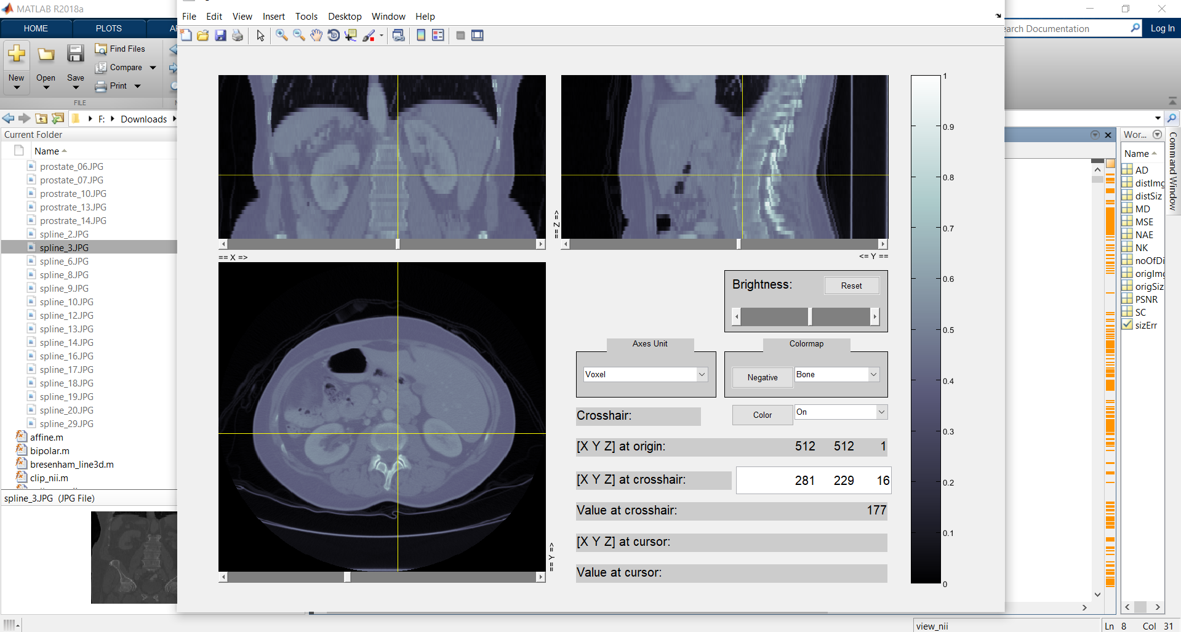

Slide 36
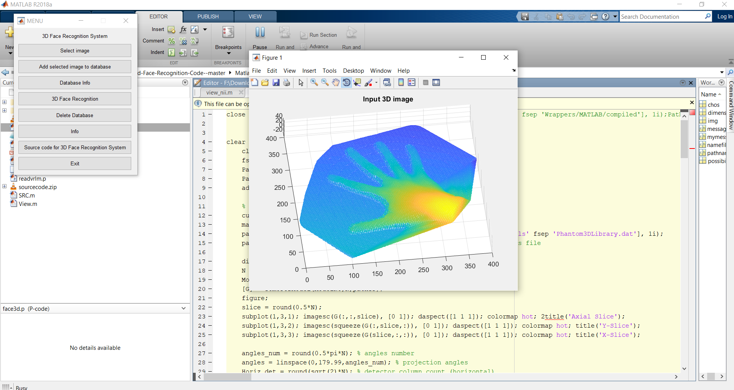

Slide 37
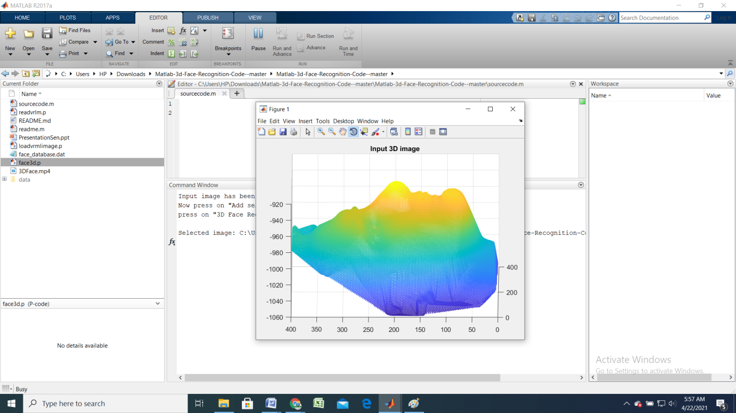

Slide 38
PUBLICATION DETAILS
Published in: IJCRT
Journal Name: International Journal of Creative Research Thoughts. Volume: Volume 9
Issue: Issue 4, April 2021.
Link: https://ijcrt.org/track.php?r_id=205584

Slide 39
CONCLUSION
A new class of methods is proposed to aim at 2D-to-3D image conversion that is based on the radically different approach of learning from examples. One method that is proposed is based on learning a point mapping from local image attributes to scene-depth.
The other method is based on globally estimating the entire depth field of a query directly from a repository of image + depth pairs using nearest-neighbor-based regression. It objectively validates the algorithms’ performance against state-of-the-art algorithms.
While the local method was outperformed by other algorithms, it is extremely fast as it is, basically, based on table look-up.
However, the global method performed better than the state-of-the-art algorithms in terms of cumulative performance across two datasets and two testing methods, and has done so at a fraction of CPU time.

Slide 40
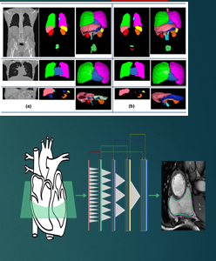
FUTURE ENHANCEMENT
With the continuously increasing amount of 3D data on-line and with the rapidly growing computing power in the cloud, the proposed framework seems a promising alternative to operator-assisted 2D-to-3D image and video conversion as well as in Robotics , to enable high level vision for robots to understands and perceive things as humans do.
In medical science for identifying
cancer, tumors ,by classifying the 3d
points rendering high dimensional
internal views.
In Robotics , to enable high level vision for
robots to understands and perceive things as humans do.

Slide 41
REFERENCE
L. Agnot, W.-J. Huang and K.-C. Liu. A 2D to 3D video and image conversion technique based on a bilateral filter. In Proc. SPIE Three- Dimensional Image Processing and Applications, volume 7526, Feb.2010.
T. Brox, A. Bruhn, N. Papen berg, and J. Weickert. High accuracy optical flow estimation based on a theory for warping. Proc. European Conf. Computer Vision, pages 25–36, 2004.
N. Dalal and B. Triggs. Histograms of oriented gradients for human detection. In Proc. IEEE Conf. Computer Vision Pattern Recognition, pages 886–893, 2005.
F. Durand and J. Dorsey. Fast bilateral filtering for the display of high- dynamic-range images. ACM Trans. Graph., 21:257–266, July 2002.
M. Grundmann, V. Kwatra, and I. Essa. Auto-directed video stabilization with robust L1 optimal camera paths. In Proc. IEEE Conf. Computer Vision Pattern Recognition, 2011.
A. Boulch, B. Le Saux, and N. Audebert, ‘‘Unstructured point cloud semantic labeling using deep segmentation networks,’’ in Proc. Eurographics Workshop 3D Object Retr., 2017, pp. 17–24.
L.-C. Chen, G. Papandreou, I. Kokkinos, K. Murphy, and A. L. Yuille, ‘‘DeepLab: Semantic image segmentation with deep convolutional nets, atrous convolution, and fully connected CRFs,’’ IEEE Trans. Pattern Anal. Mach. Intell., vol. 40, no. 4, pp. 834–848, Apr. 2018.
E. Shelhamer, J. Long, and T. Darrell, ‘‘Fully convolutional networks for semantic segmentation,’’ IEEE Trans. Pattern Anal. Mach. Intell., vol. 39, no. 4, pp. 640–651, Apr. 2017.
A. Garcia-Garcia, S. Orts-Escolano, S. Oprea, V. Villena-Martinez, and J. Garcia-Rodriguez, ‘‘A review on deep learning techniques applied to semantic segmentation,’’ Apr. 2017, arXiv:1704.06857. [Online].

